Slide 1

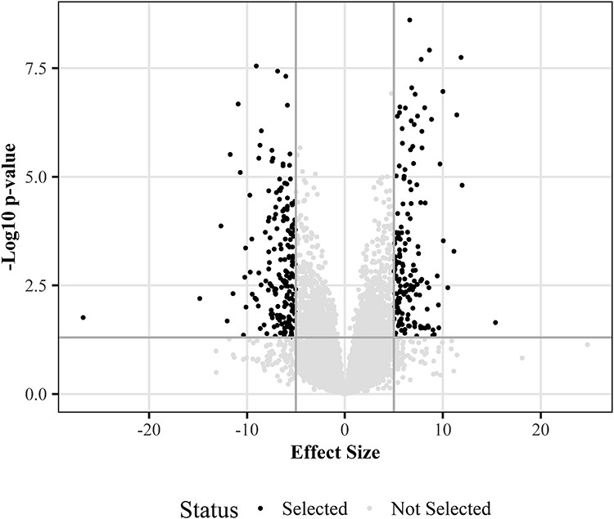
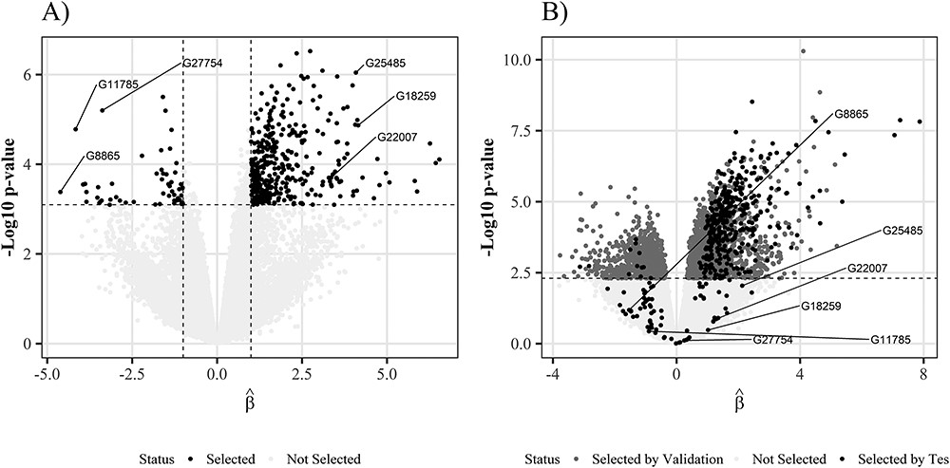
FALSE DISCOVERY RATE CONTROL IN VOLCANO PLOT FOR OMICS DATA
Célia Vidal & Vivien Dupont Data Science in Health & Biostatistics, 3rd year, Ensai
Introduction
Objectives
Methods
The most popular procedure for checking the False Discovery Rate (FDR) is the Benjamini-Hochberg procedure using only the adjusted p-values. Another procedure is the "double filter" (Volcano plot). The latter uses both the fitted p-values and the size effect. However, these procedures do not guarantee error control on the subsets and therefore they can be inflated.
Benjamini-Hochberg procedure:
Double filter procedure (Volcano plot):
Focused Benjamini-Hochberg:
Closed testing:
Explain the statistical weaknesses of conventional strategies, the procedure of Benjamini-Hochberg and the procedure of "double filter" or Volcano plot, for differential analysis (False Discovery Rate control)
Show whether the proposed approaches, the Focused Benjamini-Hochberg and the Closed testing, can overcome these weaknesses.
The Volcano plot is a scatter plot of -log10 of p-values among significant p-values after Benjamini-Hochberg correction (y-axis) versus effect size (x-axis). The most significant variables are at the top in the corners.
FIGURE 1: Volcano plot
◀
Results
Conclusion
FDR inflation occurs when FDR control procedures such as BH are combined with the Volcano Plots double filter procedure. FDR control on a set of discoveries does not imply FDR control on subsets of these discoveries. FDR inflation is high when the variance of differentially expressed genes is lower than the variance of non-differentially expressed genes. FDR inflation is less important when there are high correlations or a low proportion of null genes. Closed testing and focused Benjamini-Hochberg are two alternatives to the Benjamini-Hochberg procedure that allow double screening while controlling the FDR.
◀
FIGURE 2 : Volcano plot
Bibliography
Ebrahimpoor (2021) Inflated false discovery rate due to volcano plots: problem and solutions

